Slide 1
Analyze NYSE
Presentation by Sara Alsufiany

Slide 2
Sectors Revenue
The Top 3 Sectors that Achieve Highest Revenue Among the Years Are: Consumer Staples, Consumer Discretionary and Energy.
And The Lowest 3 Sectors Are: Materials, Utilities and Real Estate

Slide 3
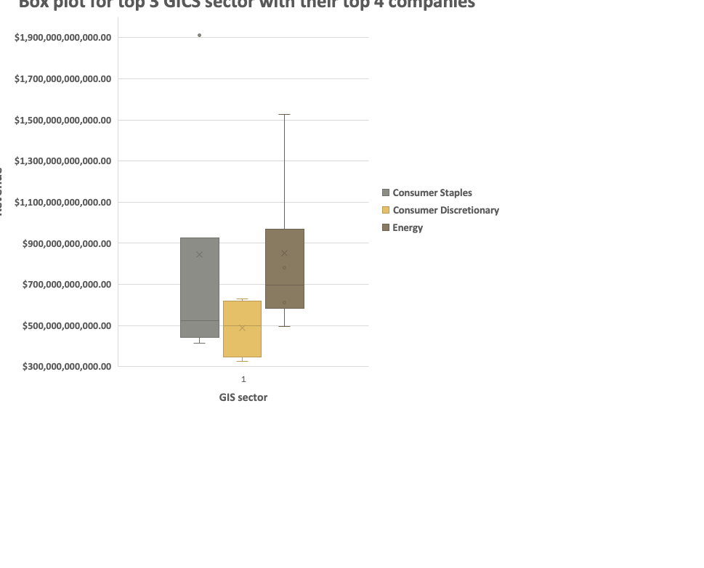
Box plot of highest industries earning
The box plot of highest 3 earning industries with their highest 4 companies, it gives us a quick insight about revenues of the highest industries, and it illustrate that there is at least 300billion dollars of revenue. Among of the three industries Energy did better which showed that it can reach to 967 billion dollars.

